Slide 1


BIA 652
Multivariate Analysis
Team Project
Analysis of Fitbit users

Slide 2
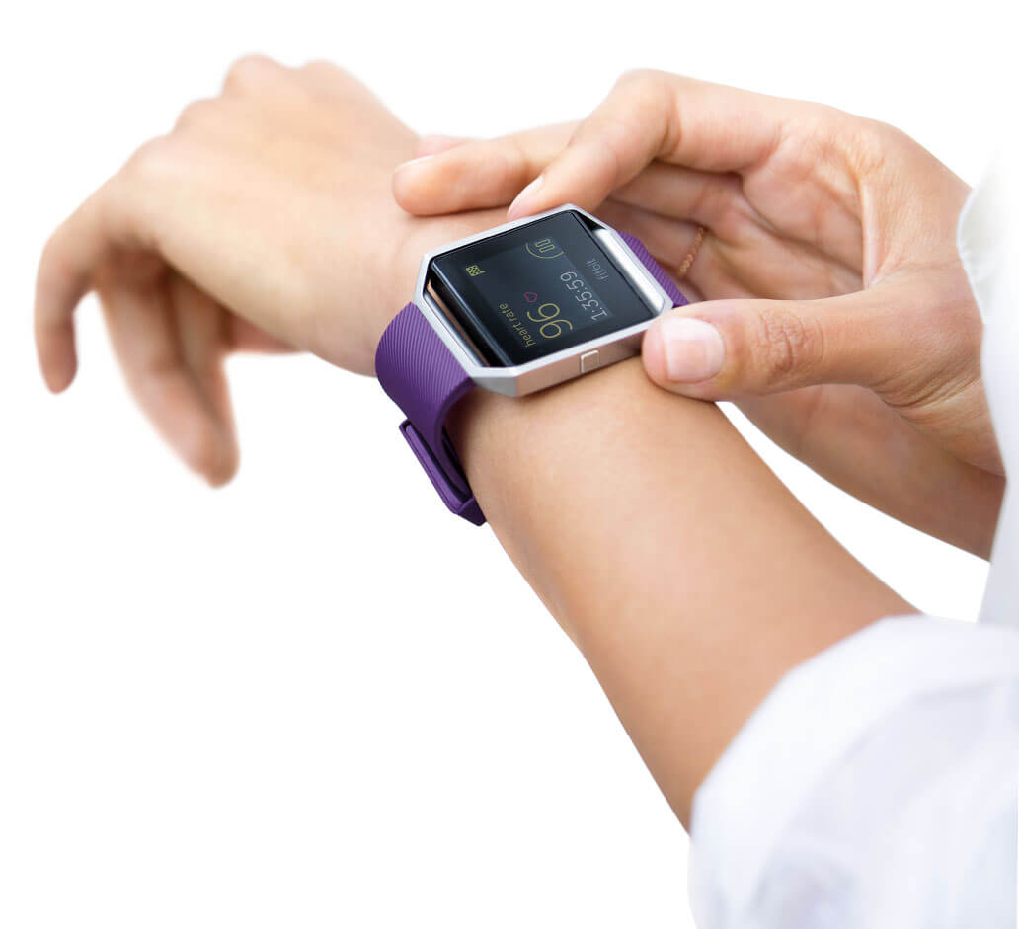
Agenda
Overview
Introduction to the dataset
Univariate & Residual Analysis
Regression Analysis
Principales Components Analysis
Evaluation & Conclusions

Slide 3
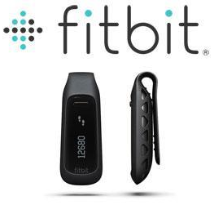
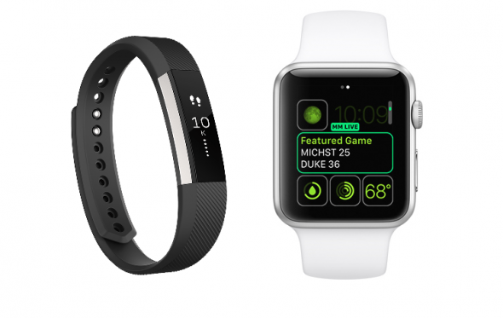
Introduction
Exploration of the benefits of (or lack thereof) wearing activity trackers.
Fitbit measure data such as the number of steps walked, calories burned, quality of sleep and other personal metrics.
There is a debate regarding the accuracy of the data collected.

Slide 4
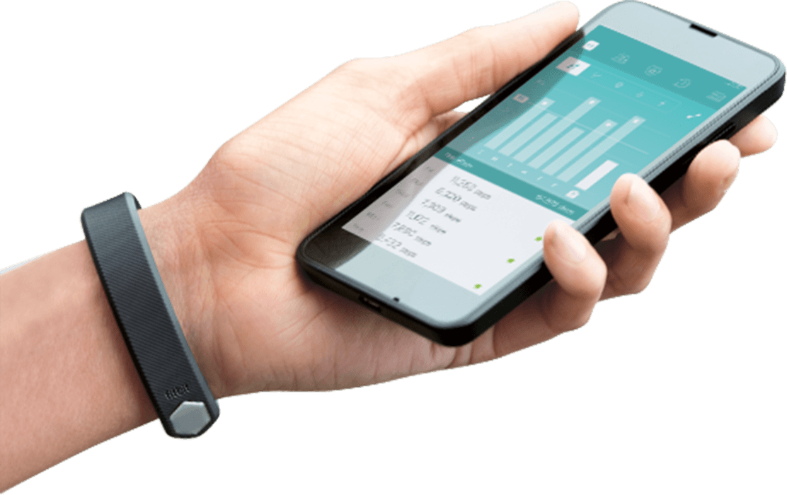
Data Source
Fitbit could not distribute personal data due to privacy procedures. Instead, we collected voluntarily offered data from two sources.
In a survey via Amazon Mechanical Turk, 38 Fitbit users consented to the submission of their personal tracker data. https://zenodo.org/record/53894#.WEyL8SgrLIV
Reddit user ‘Nougatoo’ collected fitbit data from 25 as part of a personal project and offered his dataset for our analysis.

Slide 5
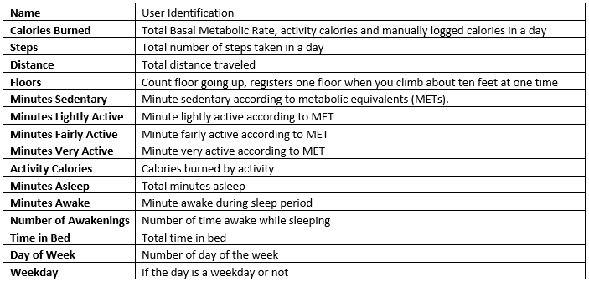
Data Fields

Slide 6
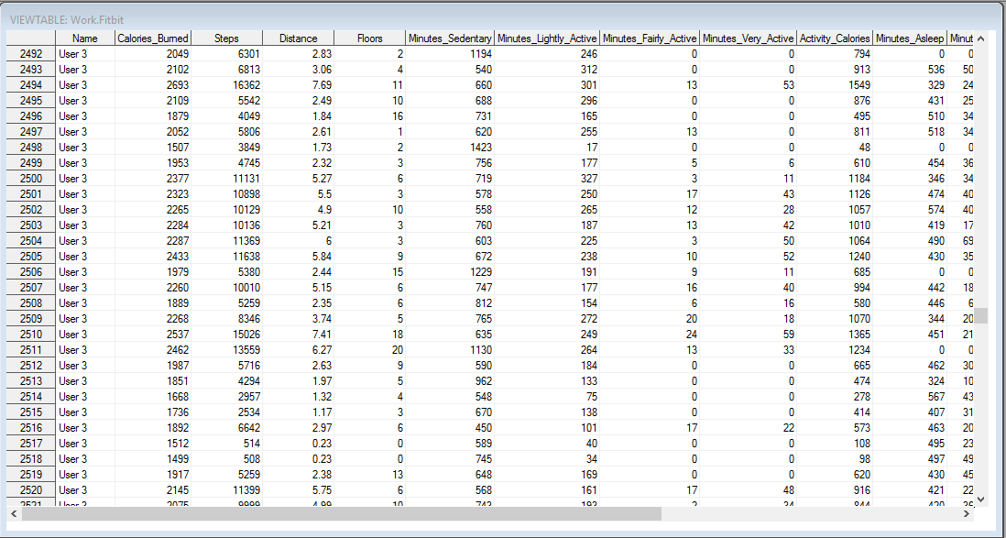
Snapshot of Data

Slide 7
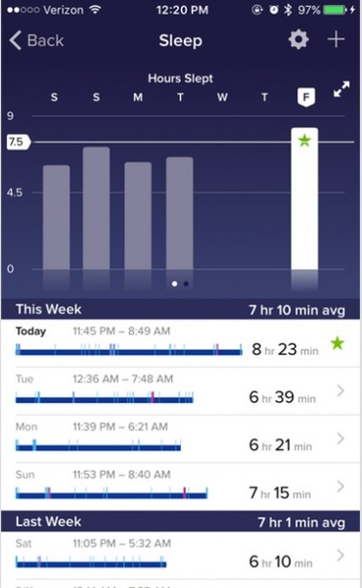
Exploration of the dataset
The two datasets had few discrepancies that needed to be cleaned in order to analyze:
Steps = ‘0’: Removed entire observations, since Fitbit was most likely not in use
Unequal time range: Created a binary variable ‘Weekday’ and took the user average of weekdays / weekends reducing all users to two rows
Zero values: Converted all significant factors to null so it does not affect analysis

Slide 8
Univariate Analysis Overview
Can day of the week predict calories burned
Can weekday or weekend predict calories burned
Do people who own a fitbit use it consistently
Does anything predict the number of steps a fitbit owner would take
Notes:
http://www.cnbc.com/2016/01/26/digital-gaming-sales-hit-record-61-billion-in-2015-report.html
http://www.gamesindustry.biz/articles/2015-04-22-gaming-will-hit-usd91-5-billion-this-year-newzoo

Slide 9
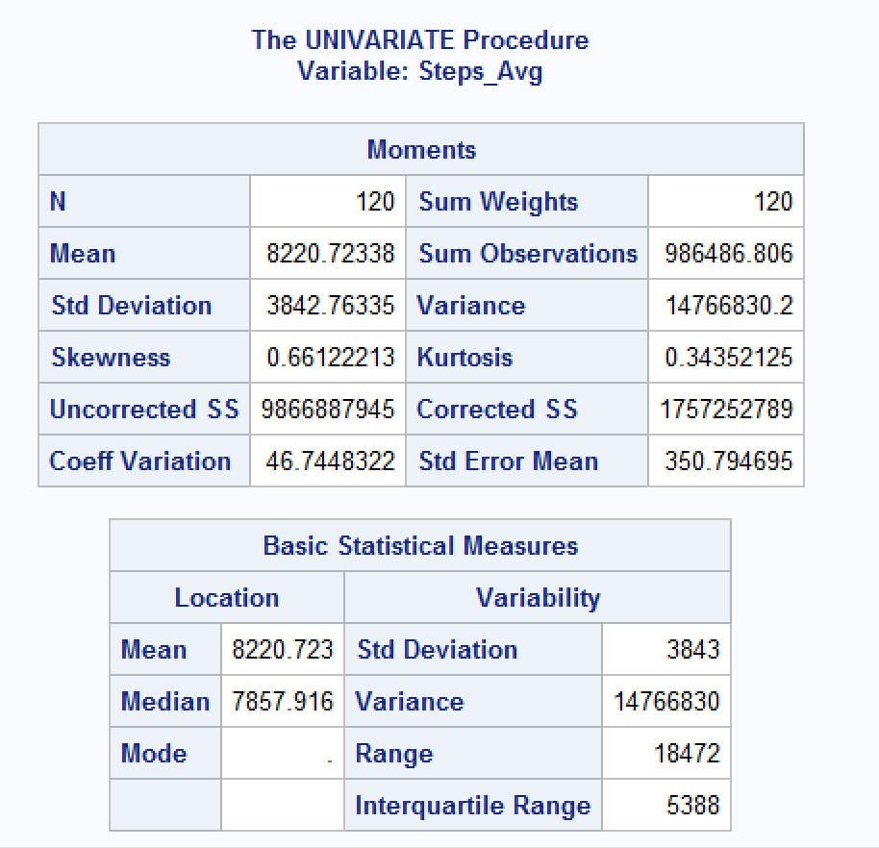
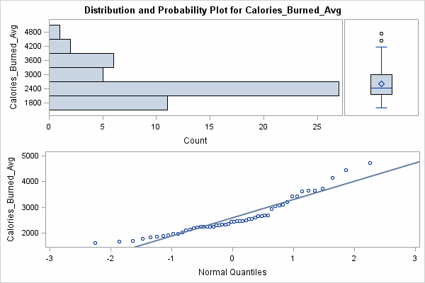
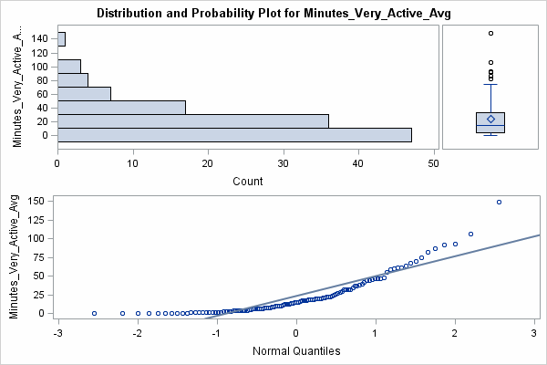
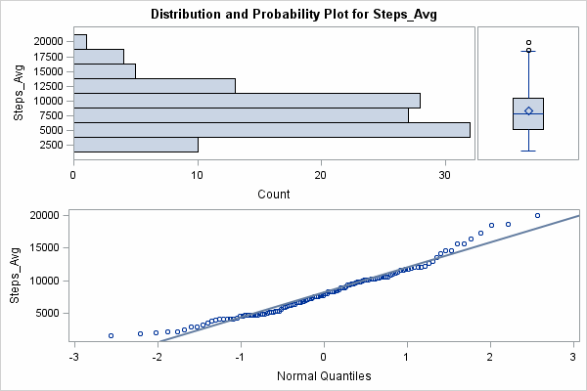
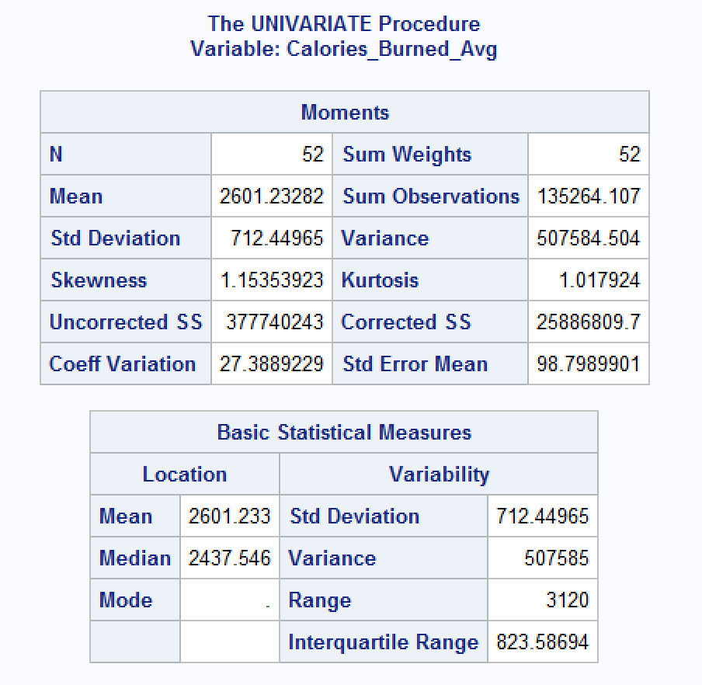
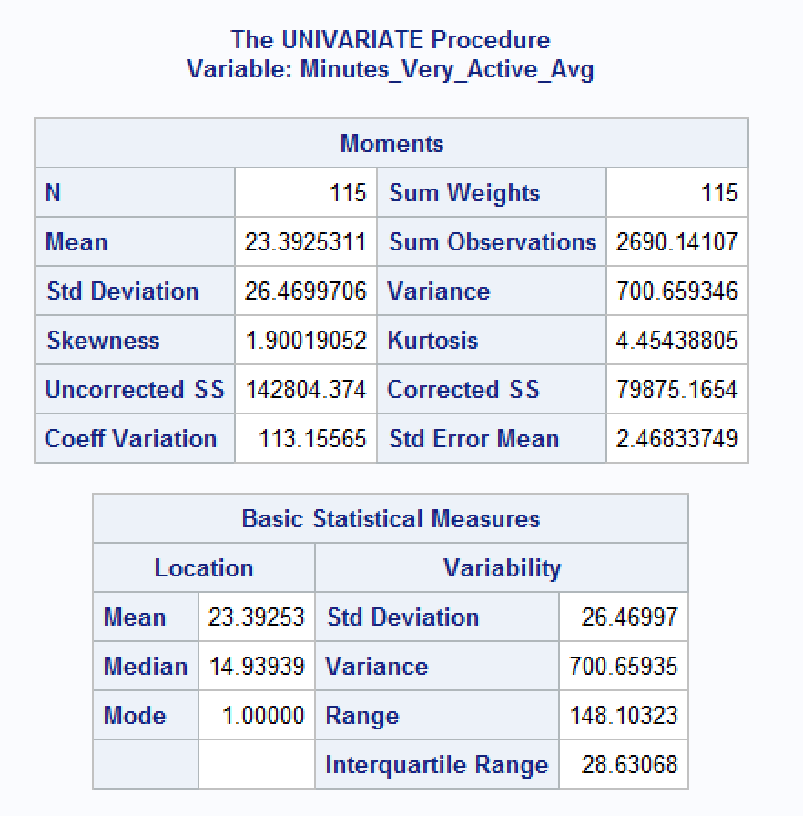
Univariate Overview
Notes:
http://www.cnbc.com/2016/01/26/digital-gaming-sales-hit-record-61-billion-in-2015-report.html
http://www.gamesindustry.biz/articles/2015-04-22-gaming-will-hit-usd91-5-billion-this-year-newzoo

Slide 10
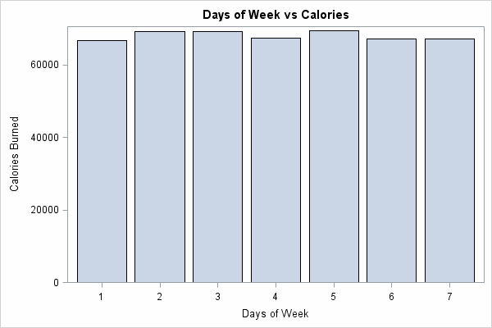
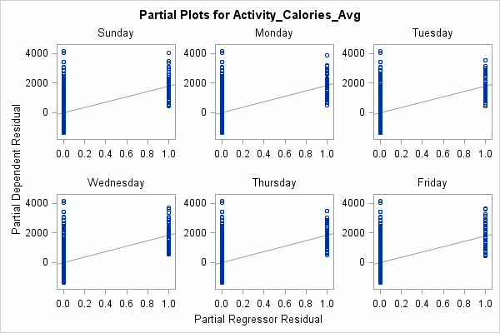
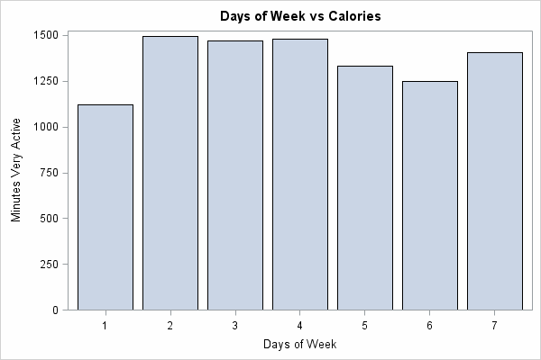
Day of the Week
Notes:
http://www.cnbc.com/2016/01/26/digital-gaming-sales-hit-record-61-billion-in-2015-report.html
http://www.gamesindustry.biz/articles/2015-04-22-gaming-will-hit-usd91-5-billion-this-year-newzoo

Slide 11
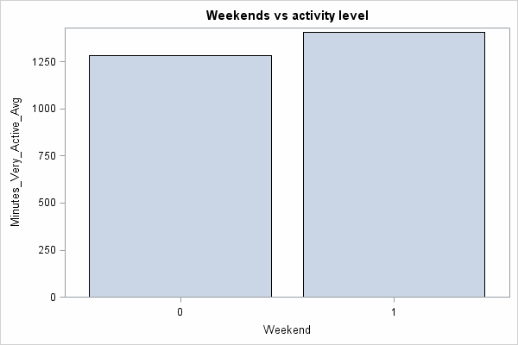
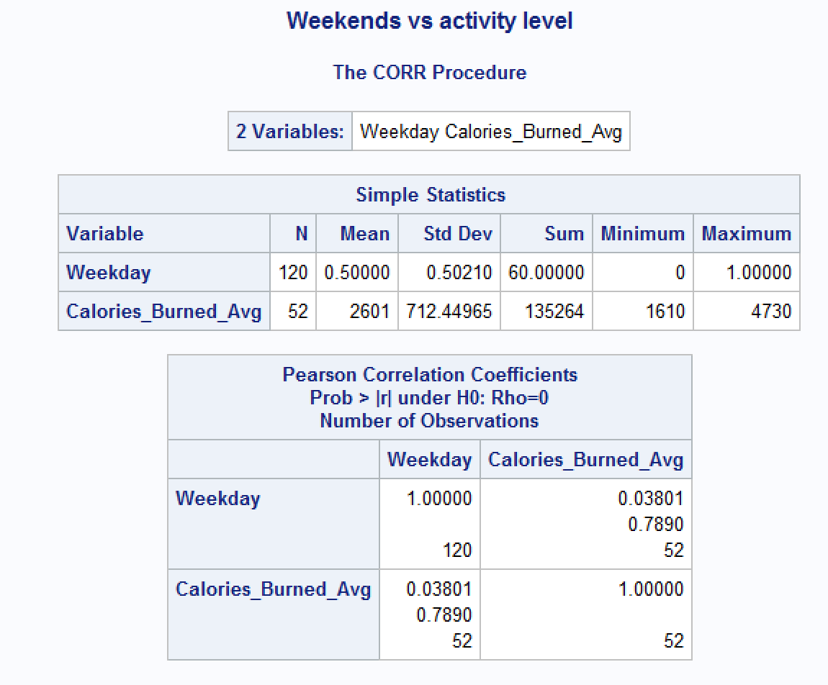
Weekday vs. Weekend
Notes:
http://www.cnbc.com/2016/01/26/digital-gaming-sales-hit-record-61-billion-in-2015-report.html
http://www.gamesindustry.biz/articles/2015-04-22-gaming-will-hit-usd91-5-billion-this-year-newzoo

Slide 12
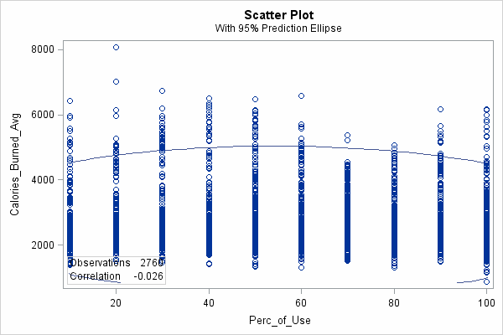
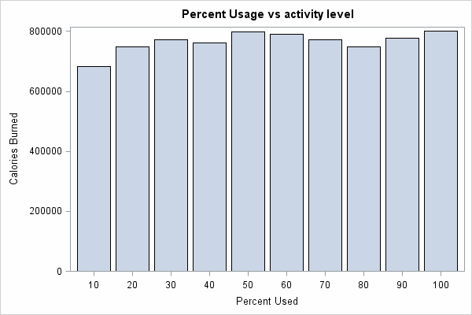
Consistency of Use
Notes:
http://www.cnbc.com/2016/01/26/digital-gaming-sales-hit-record-61-billion-in-2015-report.html
http://www.gamesindustry.biz/articles/2015-04-22-gaming-will-hit-usd91-5-billion-this-year-newzoo

Slide 13
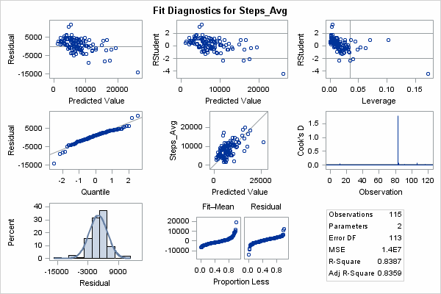
Steps

Slide 14
Multiple Regression
Dependent variable: Activity calories
Independent variables: Steps, distance, minutes highly active, minutes fairly active, minutes lightly active, minutes sedentary
Predicts what factors affect calories burnt the most and by how much

Slide 15
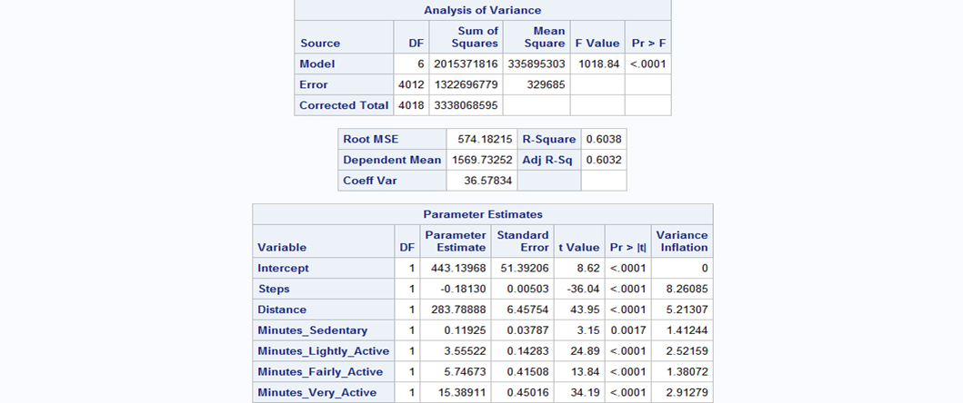
First regression model (On raw data)

Slide 16
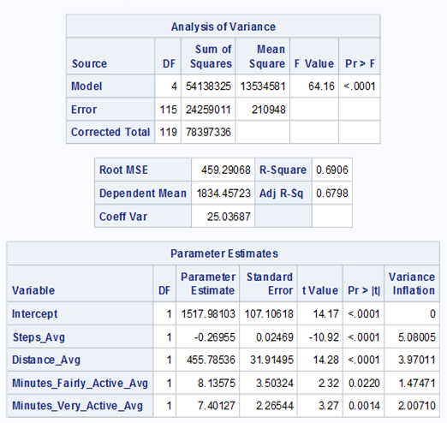
Second regression model (After taking averages)

Slide 17
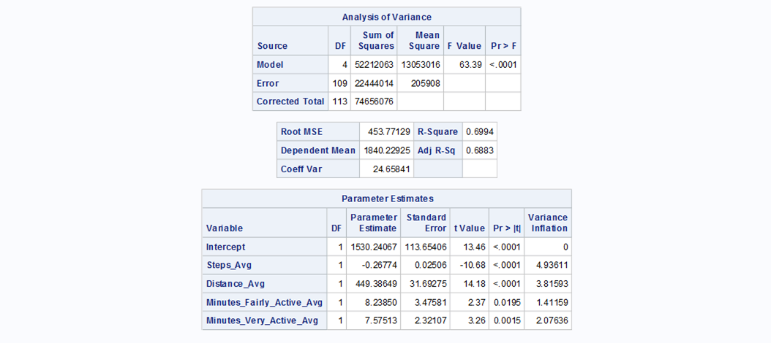
Third regression model (after converting zeroes to null)

Slide 18
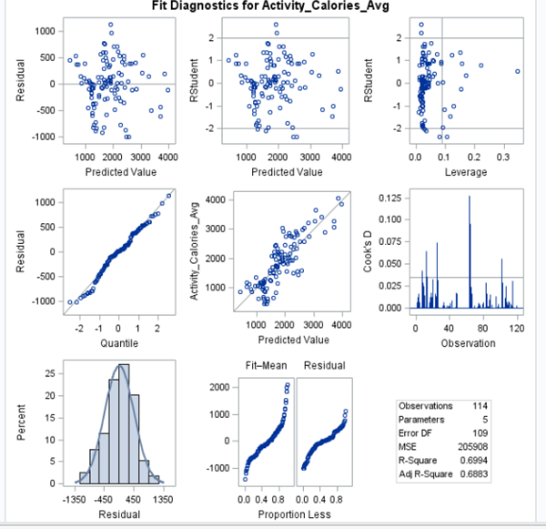
Third regression model (after converting zeroes to null)

Slide 19
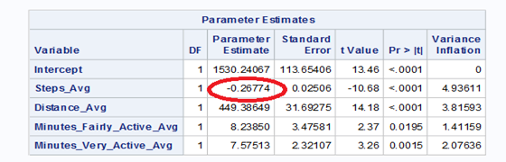
Observations
All the three models are a good fit and have significant parameters, but the third one has the best r-square value.
The VIF for all parameters is below 5, which means there is no multicollinearity.
Predictions that we can make:
For every mile covered, an average of 450 calories are burnt
For every very active minute, 7 calories are burnt
How many steps should one take to burn 500 calories
We see that the steps variable has a negative parameter
estimate, which is peculiar. Also, the parameter estimate
for distance seems too high.

Slide 20
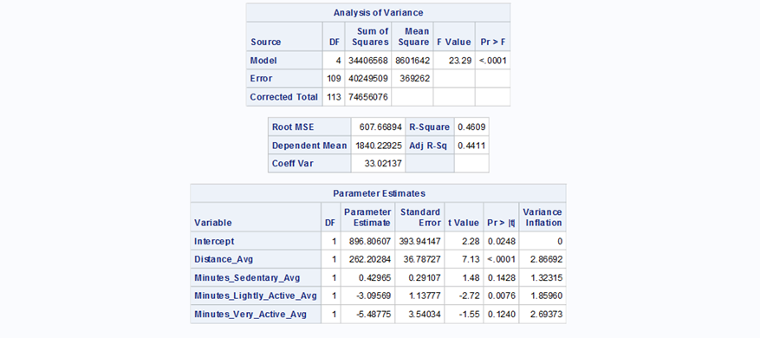
Observations
We first ran a regression separately on average steps to check the parameter coefficient.
It returns positive, thought the value is very low, and is significant.
We then ran a regression by removing steps from the model, but the r-square drops down significantly.

Slide 21
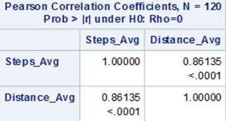
Observations
Next, we checked the correlation between distance and steps which came out to be very high.
The peculiarity in their parameter estimates may be a result of this correlation, so we found it prudent to run a Principle Component Analysis

Slide 22
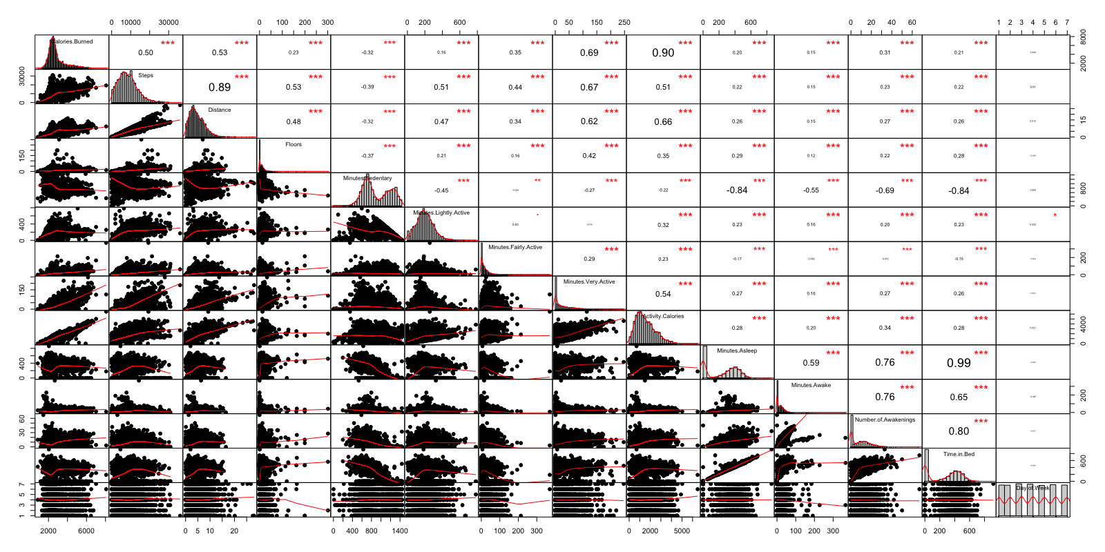
Correlation Matrix
Notes:
We wanted to showcase some of the collinearities from our dataset.
We are looking for highly correlated data, reason why we do pca,

Slide 23
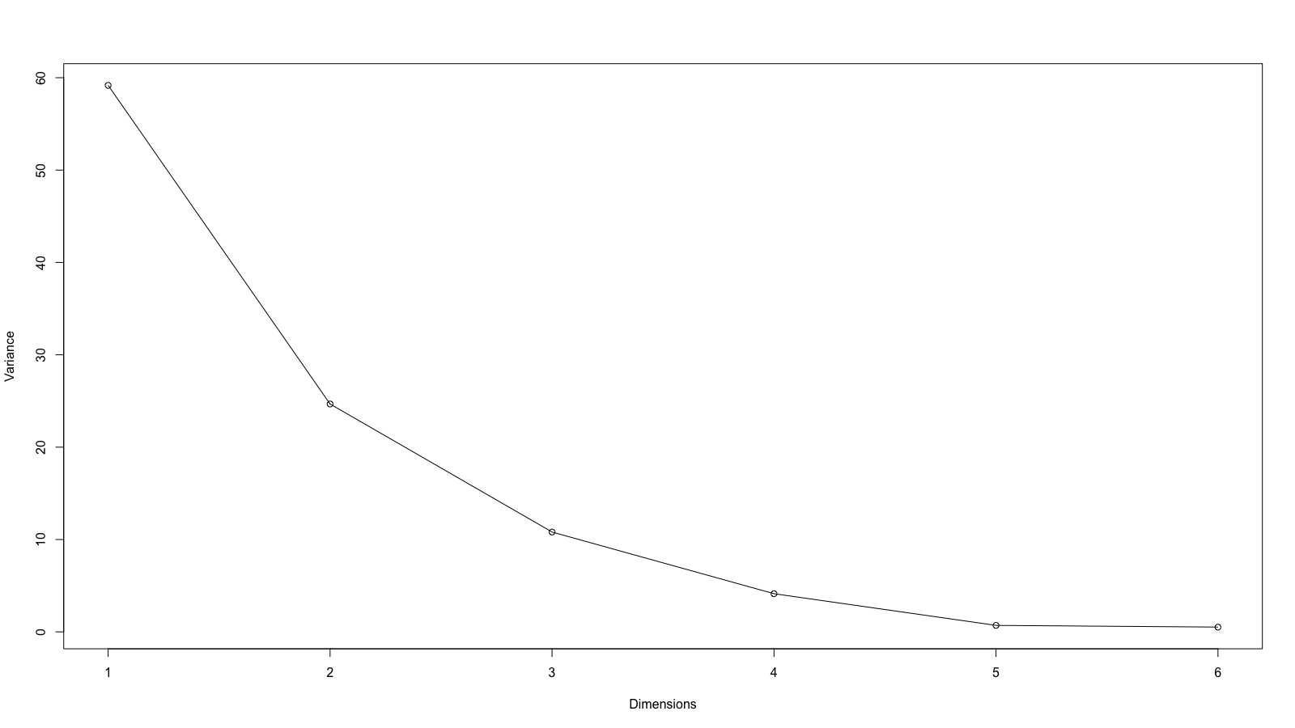
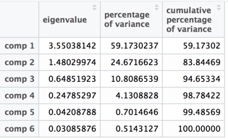
Percentage of inertia
Notes:
How many dimension do we want to interpret?
Here with 3 variables components we can explain 95% of the variation: if we summarize the variables
We don’t need to look at the 3 last principals components
This means that we have strong correlation among some of the data points

Slide 24
Percentage of inertia
Explain ~95% of the variation
Notes:
How many dimension do we want to interpret?
Here with 3 variables components we can explain 95% of the variation: if we summarize the variables
We don’t need to look at the 3 last principals components
This means that we have strong correlation among some of the data points

Slide 25

Standard deviation of importance
Notes:
Eigen value refers to the standard deviation (square). They need to be above 1. Meaning they explain at least as much variation as our initial variables
The 6 components should explain the full variation of the data

Slide 26
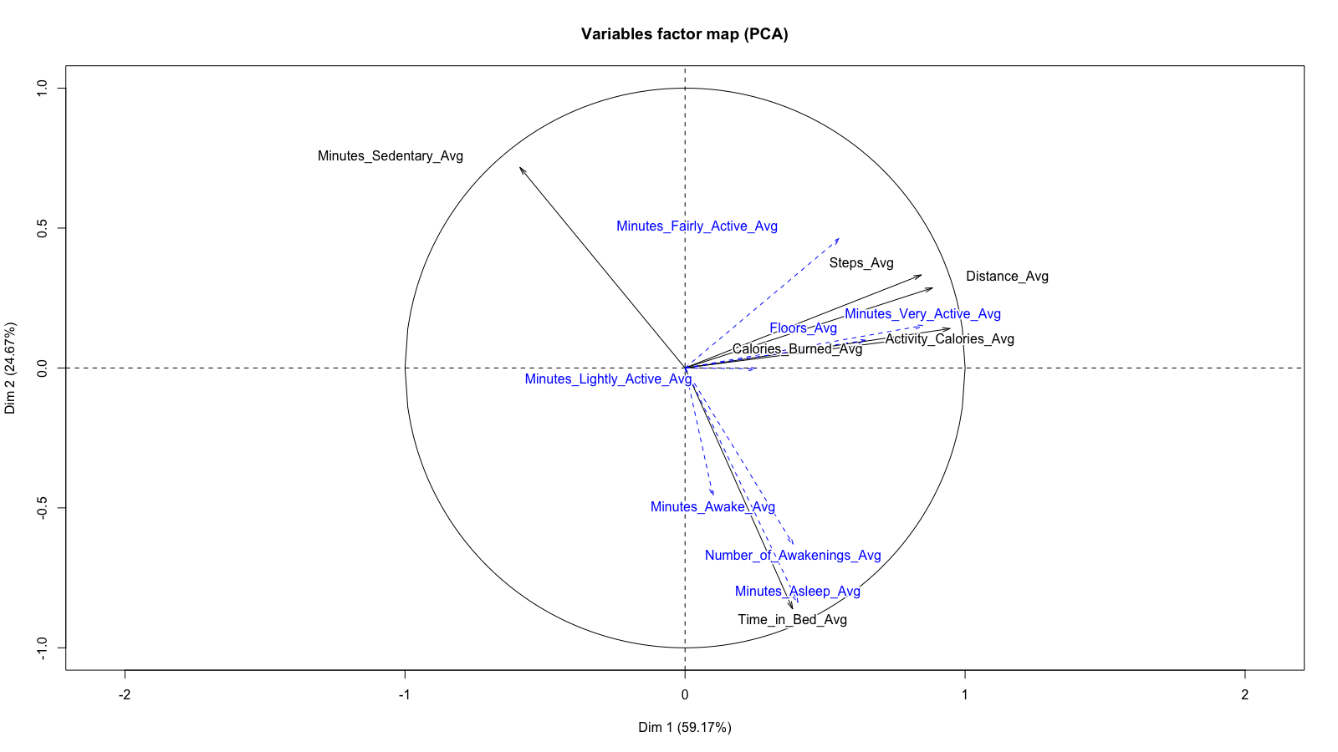
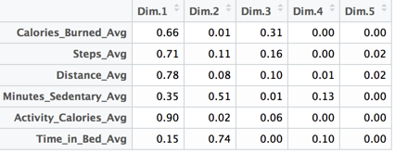
Interpretation of the PCA
Notes:
Only the elements well projected (sum of dim1+dim2) for a variable is close to 1 => activity_calories, time in bed,

Slide 27
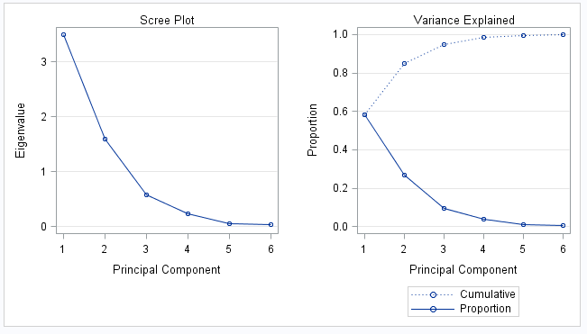
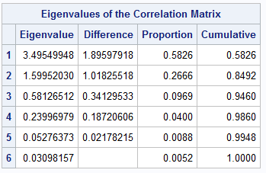
PCA in SAS
Notes:
Ways to choose components
Eigenvalue around 1, where high drop off and then evens out (bent elbow analogy)
Cumulative explained by 70-80%
Both tell us only first 2 principle components

Slide 28

Conclusion

Slide 29
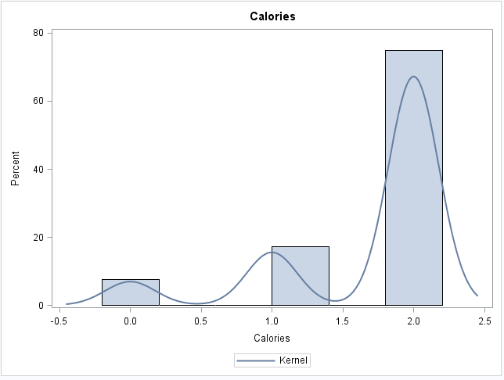
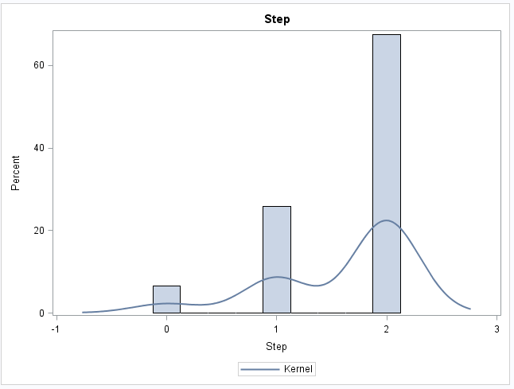
Impact of wearing Fitbit on individual
Based on our dataset we concluded that people who wear fitbit burn more calories and walk more steps than the average american
Americans burn
1900 ~ 2300 Calories
Americans take
3000 ~ 5117 steps
Notes:
The average calories burned for American 1900 - 2300 - http://healthyeating.sfgate.com/typical-calories-burned-sedentary-lifestyle-5270.html
The average steps taken by American 3000 - 5117 - http://www.businessinsider.com/heres-how-much-the-average-american-walks-every-day-2015-7

Slide 30
Quality & Accuracy of the dataset
Data Preparation and exploration took 50% of the time.
After doing our analysis, we concluded that this dataset is only partially reliable.
The lack of personal data like age of user, gender, BMI, can impact the data
Notes:
So even though we have can see a person is burning only 500 calories by doing activity the total calories burned is close to 4000 we don’t know if it was manually added or if the person is huge and have a high BMR

